Slide 1
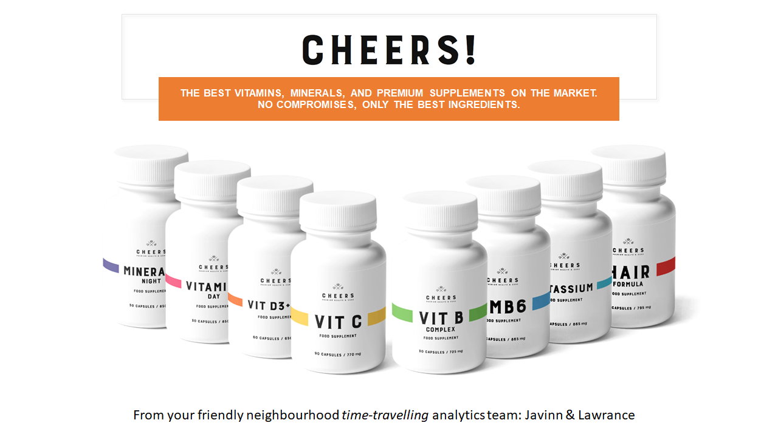
Cheers
To greater profits
Javinn & Lawrance

Slide 2
Business Objectives (& Assumptions)
Discover client profiles
Identify profitable segments
Propose solution(s)
HTML, CSS,JS
Prescribe the go-to-market strategy for Cheers! ecommerce website created for online shopping
It’s the year 2002
You, our audience, are a team of marketing people (Not techies; Not scientists; No nerds)

Slide 3
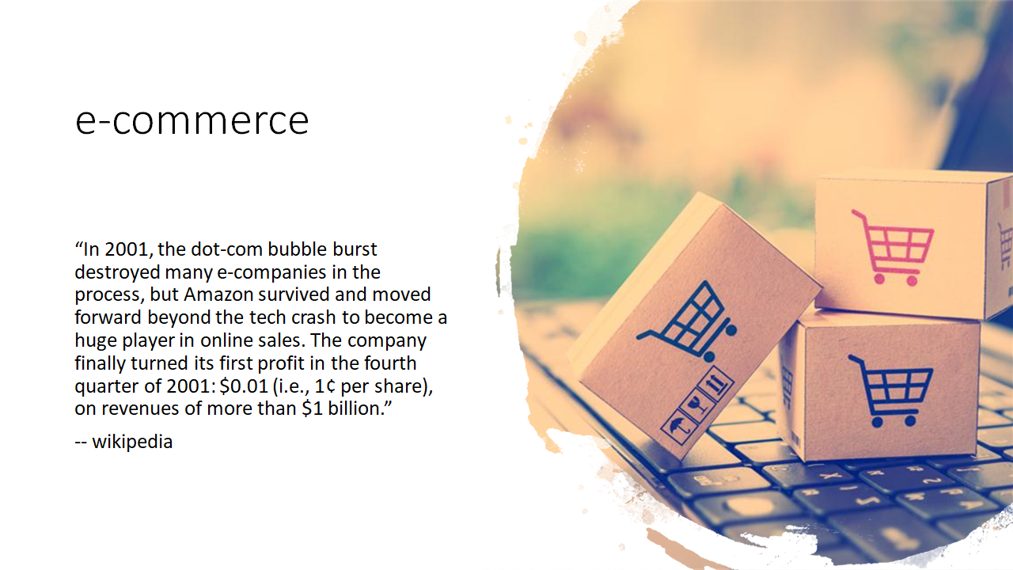

Slide 4
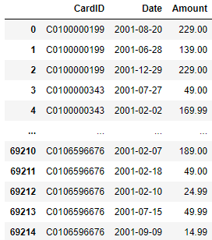
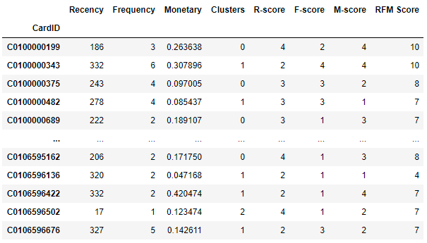
The data
What we did
Customer transaction data spanning the year of 2001
69215 entries
69215 → 12589 entries
Parse dates & transform data
Engineer RFM and RFM score features
K-means clustering (low dimensions)
Perform group-by(s) for more insight

Slide 5
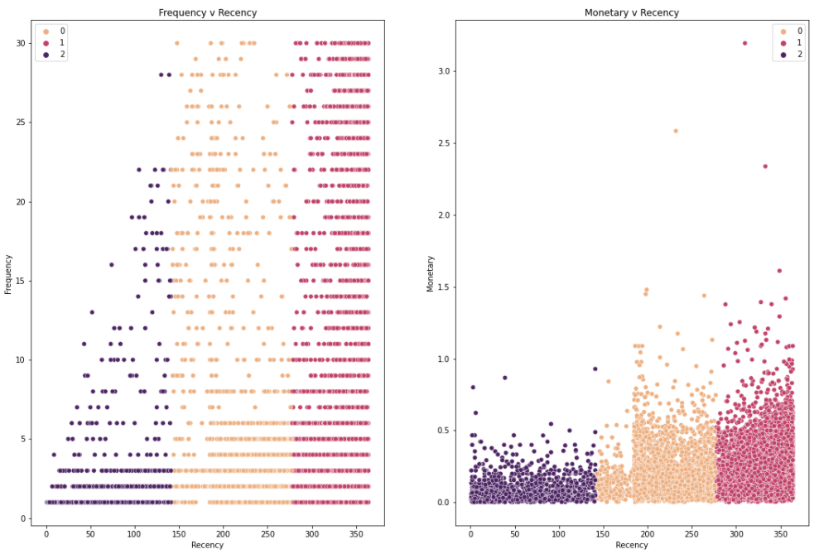
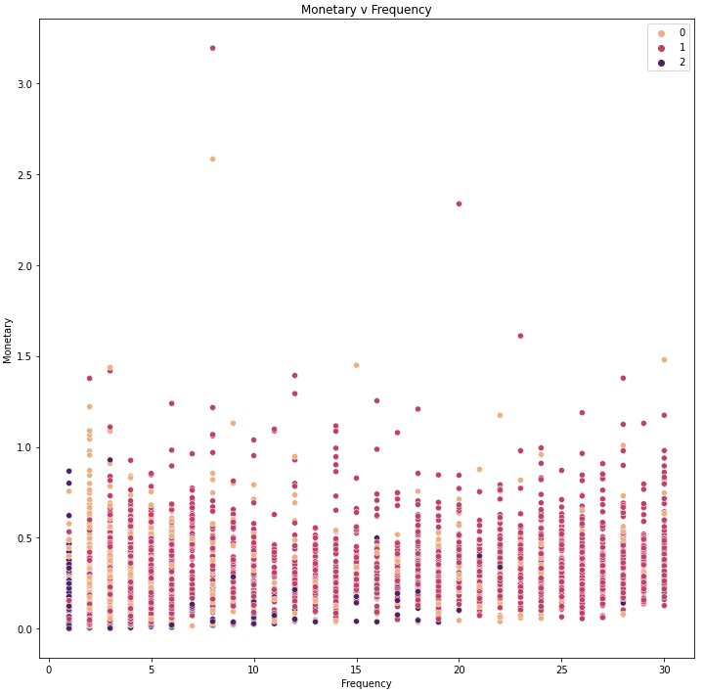
Our customers
Our most frequent customers are at risk of churn
These same customers also spend larger amounts over multiple periods

Slide 6

Go-To-Market
Phase 1 - Soft launch
Engage using Pareto’s Rule
Work out operational / fulfilment kinks
Solicit / collect feedback and data
Phase 2 - Official launch
Comms to all other members to enroll
Work on feedback gathered from Phase 1
Solicit / collect feedback and data
Phase 3 - Operationalise
Rollout to public to solicit new sign-ups
Work on feedback gathered from Phase 2

Slide 7


Slide 8
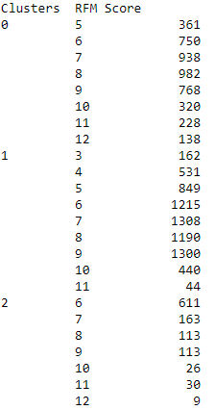
Phase 1 - Soft Launch
Activities
Comms to Clusters 0 & 1 clients (begin winback)
Sign up incentives
Free shipping
Badge / recognition
Rewards / cashback system
Work out operations & fulfilment kinks
CRM
Feedback and data capture
Understand what led to clients’ churning
Form KPI metrics / benchmark to track various operational performance

Slide 9

Phase 2 - Official launch
Activities
Comms to rest of members
Sign up incentives
Free shipping
Rewards / cashback system
Beef up operations & fulfilment capacities
CRM
Fine tune operational KPI metrics
Email / newsletter campaign
Categories / best sellers
Exclusive online promotions

Slide 10
Phase 3 - Operationalise
Activities
Comms to rest of the world
Online advertising (CPC / CPM)
Free shipping
Membership
Rewards / Cashback system
CRM
Measure, track and optimise customer acquisition ROI
Shopping cart cross-sell / up-sell; product recommender

Slide 11
Thank you

